Slide 1
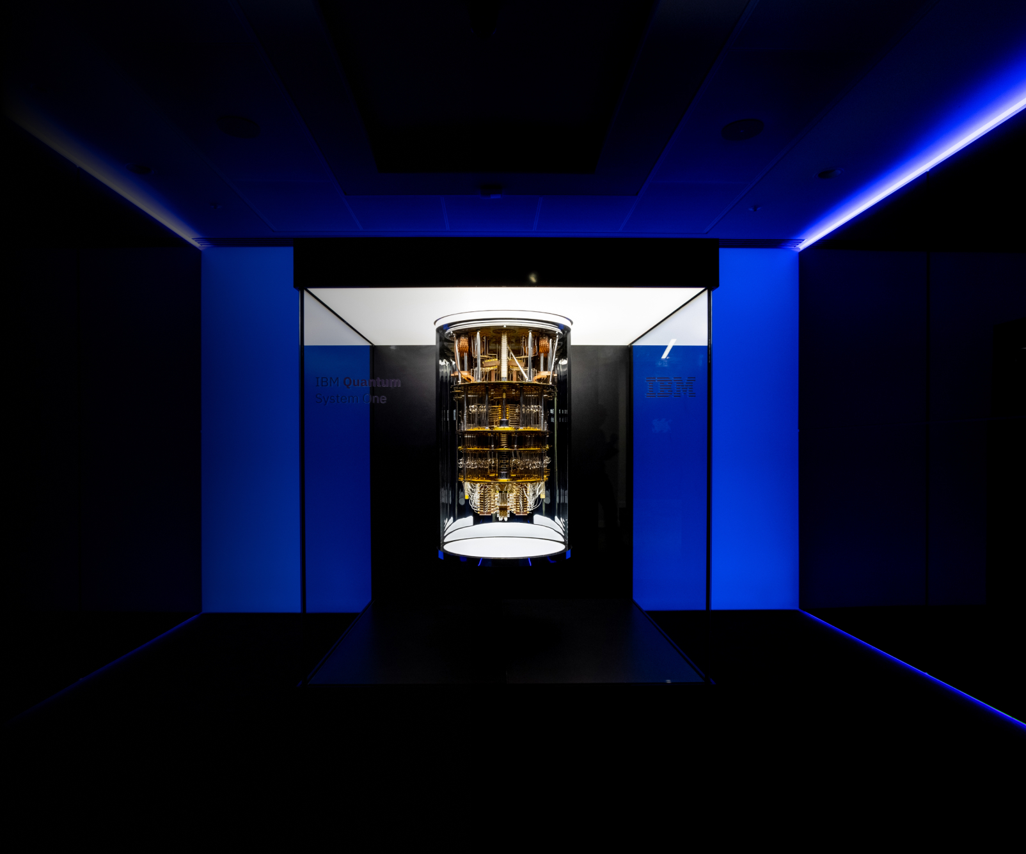
Introducing Quantum Computing to Computer Science Students
STEM REx
Presented by Nole Stites
Notes:
- System One was finished in the summer of 2018 after precise testing.
- The computers are super cold: Absolute Zero = -460 Fahrenheit.
- System One’s exist in North America, Germany, and Japan, soon to be more.
- IBM had quantum computers on the cloud as early as 2016.
- IBM allows users to create quantum circuits and run them on their quantum computers.

Slide 2
What makes quantum computing interesting?
Quantum computers have a massive increase in computational power compared to classical computers.
Can solve many complex problems in a reasonable amount of time, unlike classic computers.
Example: Google’s quantum computing experiment [4]
It has important applications in these (and many more) subject areas:
Medicine [2]
Climate Modeling [3]
Post-Quantum Cryptography [5]
Artificial Intelligence [6]
It uses quantum physics, a strange yet fascinating new area of study for computer scientists.
IBM, Google, Microsoft, and many more are all working to advance quantum computing research.
The title slide image is IBM’s quantum computer called System One.
Notes:
[4] A computation that would take an estimated 10,000 years to do on the fastest supercomputer took 200 seconds on Google’s quantum machine.
[5] The need arose to design new cryptographic algorithms that could withstand attacks by quantum computers

Slide 3
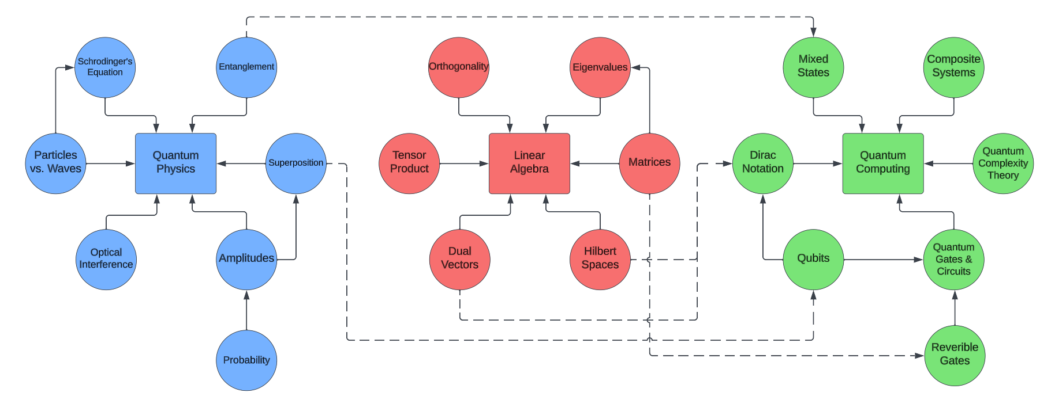
Traditional Learning Path for Quantum Computing
Graph:
a collection of vertices (nodes) and edges such that any edge in the graph will connect two nodes.
Dependencies in a graph:
Directed edges in a graph are known as dependencies. The node that the edges points to depends upon the node at the origin of the edge.
Notes:
- Each square node is a different course
- Each circle node is a sub-topic
- In reality, each topic is HUGE; mine is small to fit summer break.
- Dashed lines are dependencies between topics

Slide 4
Problems when teaching quantum computing
A couple of problems arise when trying to teach quantum computing:
The nature of quantum physics is strange and hard to grasp.
I am giving an introductory lecture on quantum computing to a class that does not require linear algebra as a prerequisite.

Slide 5
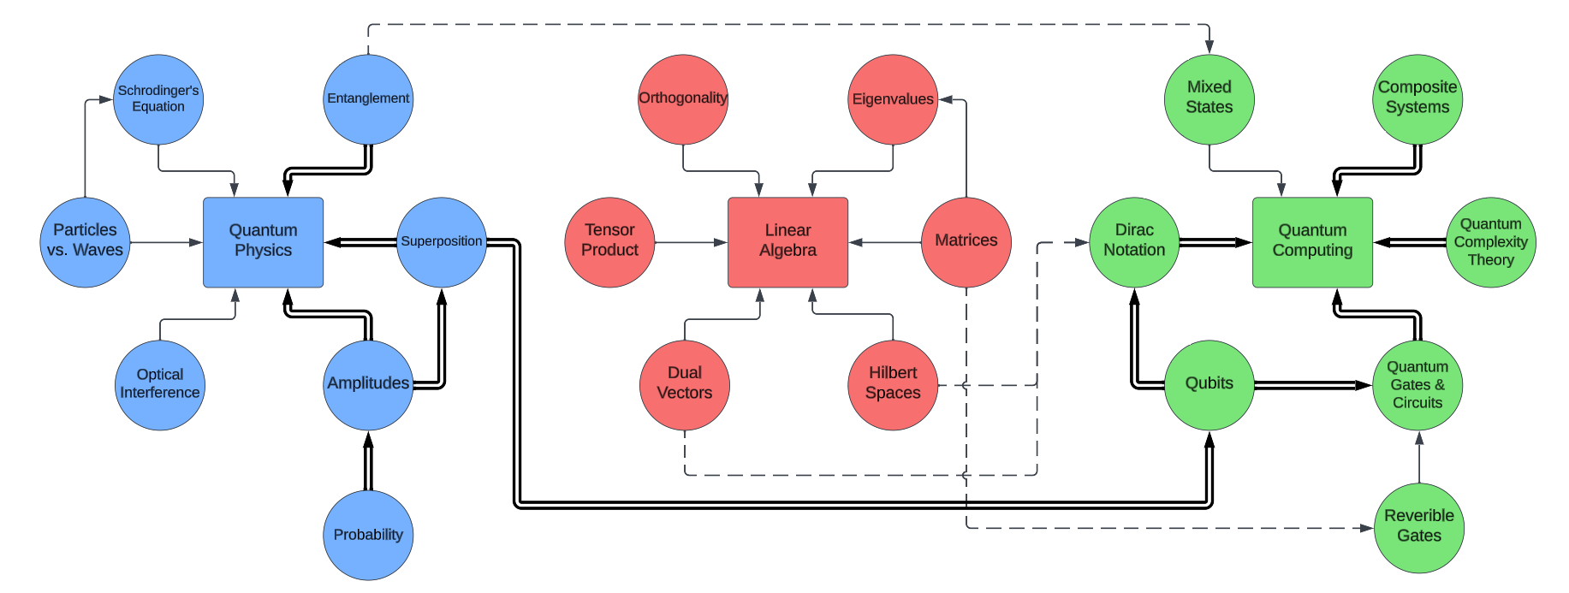
Contributions
Researched a slice through the traditional graph to serve as a quantum computing learning path for students that doesn’t involve linear algebra.
Prepared an introductory lecture on quantum computing to be presented to CS 418 students.
Created a machine-readable knowledge graph to represent the quantum computing learning path.
Learning Path Slice:
a smaller collection of vertices and edges from within a larger graph.

Slide 6
Steps to achieve the resulting contributions
Learned quantum computing the traditional way through self-study.
Drafted a lecture outline, received feedback, and repeated until a satisfactory outline was created.
Encoded my knowledge of quantum computing into a graph that followed the structure of the lecture outline.

Slide 7
Step 1: Learn Quantum Computing
The Traditional Way
Learn Quantum Physics
Superposition
Entanglement
Schrodinger’s Equation
Particles vs. Waves
Repeated Measurements
Etc.
(In other words, the strange quirks of the quantum world)
Learn Quantum Computing
Linear Algebra
Dirac Notation
Qubits & Mixed States
Quantum Gates/Circuits
Quantum Complexity Theory
Etc.
(Applying quantum weirdness to make it useful)

Slide 8
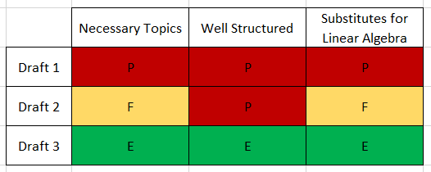
Step 2: Draft Lecture Outlines
Necessary Topics: Does the draft contain digestible and meaningful topics for an introductory lecture?
Well Structured: Is the content of the draft organized in a clear and understandable way?
Substitutes for Linear Algebra: Does the draft avoid the use of linear algebra by using another effective method?
Poor
Fair
Excellent
“Critiquing is much easier than conceiving”
Notes:
Discuss why drafting is important. Just look what would’ve happened if you stopped at Draft 1!

Slide 9
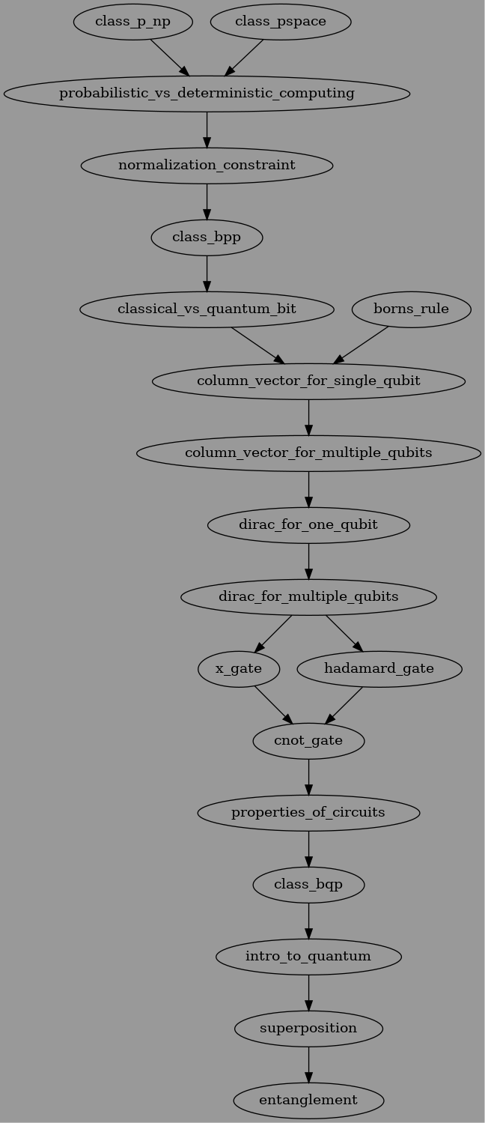
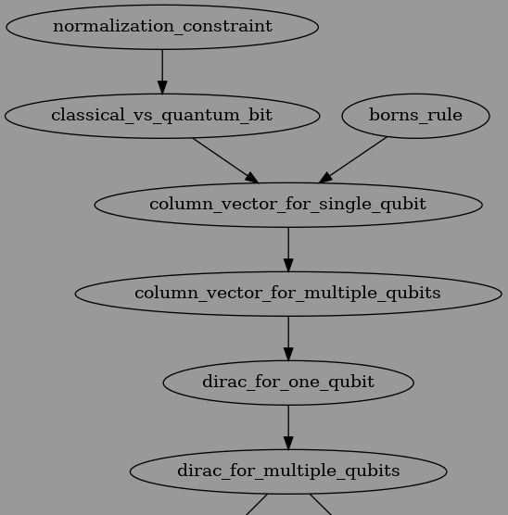
Step 3: Encode Knowledge Into Graph
Why use a graph?
To allow for an easy way to reorganize the structure of the learning path by moving around the nodes.
To provide learners with a roadmap of topics to learn and in what order (knowledge graphs have been shown to be useful for this)
To have a machine-readable format for a variety of uses.

Slide 10
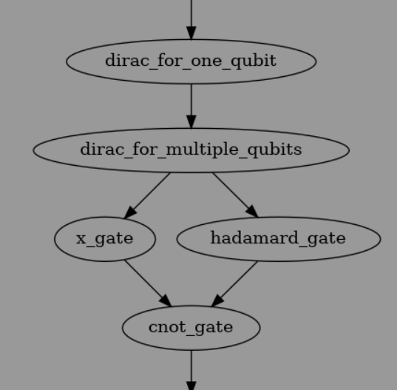
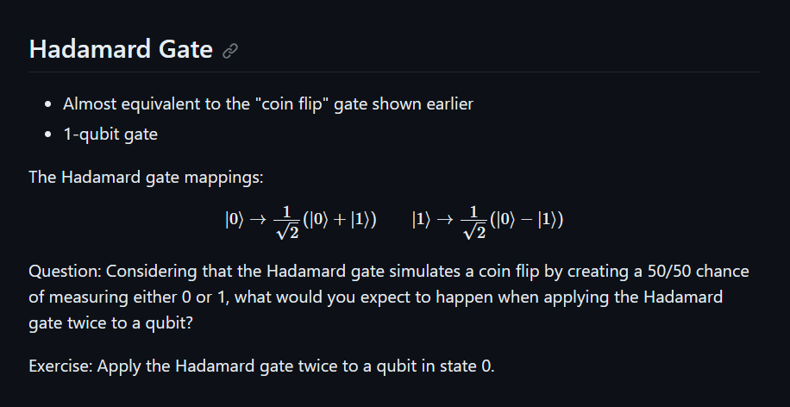
Example Lecture Slide

Slide 11
Conclusion
Researched an introductory learning path for quantum computing that does not involve linear algebra.
Populated the nodes on the learning path with my newfound knowledge of quantum computing to create a lecture introducing quantum computing to CS students.
I will be presenting this lecture to CS 418 students in Winter 2024 to test the effectiveness of my work and make modifications as needed.
Notes:
Every one of the nodes in your graph has a lecture slide associated with it.

Slide 12
Questions?

Slide 13
Sources
IBM Quantum Field Guide:
https://quantum-computing.ibm.com/lab/docs/iqx/guide
Online lecture series: https://youtube.com/playlist?list=PLkespgaZN4gmu0nWNmfMflVRqw0VPkCGH
Books:
“The Strange World of Quantum Mechanics” by Daniel F. Styer
“An Introduction to Quantum Computing” by Phillip Kaye, Raymond Laflamme and Michele Mosca
Additional References:
[1] Aidan Hogan, et al. 2020. Knowledge Graphs. arXiv:2003.02320 [cs.AI]
[2] Flöther, F., & Griffin, P. (2023). How can quantum technologies be applied in healthcare, medicine and the life sciences? Research Directions: Quantum Technologies, 1, E7. doi:10.1017/qut.2023.1
[3] Marcin Frąckiewicz (2023). The Role of Quantum Computing in Weather Forecasting and Climate Modeling. TS2 Space.
[4] John Martinis, Sergio Boixo (2019). Quantum Supremacy Using a Programmable Superconducting Processor. Google Research.
[5] NIST (2022). NIST Announces First Four Quantum-Resistant Cryptographic Algorithms.
[6] Cem Dilmegani (2022). In-Depth Guide to Quantum Artificial Intelligence in 2023. AIMultiple.

